Slide 1
Week 5 – Part2
A Brief Review with a focus on Week 3 Assignment
Scalar functions
More Subqueries

Slide 2
Question 1
We want the AddressID, AddressLine1, AddressLine2, and City of the persons without any null values in their AddressLine2. Sort your query by city. How many are they?
AdventureWork2014 database
Select AddressID, AddressLine1, AddressLine2, City
from Person.Address
where AddressLine2 is not null
order by City;

Slide 3
Question 2
We want the AddressID, AddressLine1, AddressLine2, and City of the
persons without any null values in their AddressLine2 who are living
in Los Angeles or Toronto.
Select AddressID, AddressLine1, AddressLine2, City
from Person.Address
where AddressLine2 is not null and City IN ('Los Angeles', 'Toronto')
order by City;
better to use OR instead of IN

Slide 4
Question 3
We want the AddressID, AddressLine1, AddressLine2, and City of the
persons without any null values in their AddressLine2 who are living
in Los Angeles, Toronto, or Downey.
Select AddressID, AddressLine1, AddressLine2, City
from Person.Address
where AddressLine2 is not null and City in ('Los Angeles','Toronto','Downey');

Slide 5
Question 4
A) We need all information in ProductCostHistory with the
StandardCost between 100 and 120 sorted by the ModifiedDate.
B) Write a second query and show all standardcot more than 2000.
Execute both queries and show the results in one result’s window.
Query A:
Select * from Production.ProductCostHistory
where StandardCost BETWEEN 100 and 120
order by ModifiedDate;
Query B:
Select * from Production.ProductCostHistory
where StandardCost > 2000;

Slide 6
Question 5
Write a T-SQL command to show 10 first BusinessEntityID, FirstName, LastName, and ModifiedDate of the persons with lastnames ending with ‘ll’ and starting with ‘Ru’ and firstname starting with ‘B’.
SELECT TOP 10 BusinessEntityID,
FirstName, LastName, ModifiedDate
FROM Person.Person
WHERE LastName LIKE '%ll' AND LastName LIKE 'Ru%' and FirstName LIKE 'B%';
Is it possible to write the query simpler?

Slide 7
Question 6
Write a T-SQL command to show 10 first BusinessEntityID, FirstName, LastName, and ModifiedDate of the persons with lastnames ending with ‘
ll’ and Firstname with exactly three characters.
SELECT TOP 10 BusinessEntityID,
FirstName, LastName, ModifiedDate
FROM Person.Person
WHERE LastName LIKE '%ll' AND LEN(FirstName) = 3;
We have not talked about LEN function yet. How we could write this query?

Slide 8
Question 7
Write a T-SQL command to show 10 first BusinessEntityID, FirstName, LastName, ModifiedDate, Today’s date As ‘Today’, and Total days past from the modified date till current date (change the column name to ‘Days Past’) of the persons with lastnames ending with ‘ll’ and Firstname with exactly three characters. *You have to use scalar functions such as Getdate() and Cast().
SELECT TOP 10 BusinessEntityID, FirstName, LastName,
CONVERT(VARCHAR,CAST(Mod ifiedDate AS DATE), 103) AS ModifiedDate,
CONVERT(VARCHAR,CAST(GETDATE() AS DATE), 103) AS 'Today',
DATEDIFF(MONTH, ModifiedDate, GETDATE()) AS 'Days Past'
FROM Person.Person
WHERE LastName LIKE '%ll' AND LEN(FirstName) < 4
Simpler Query
SELECT TOP 1000 [BusinessEntityID], [FirstName] ,[LastName] ,[ModifiedDate]
,GETDATE() As Today
,CAST(GETDATE() - ModifiedDate as int) As DaysAgo
FROM [AdventureWorks2014].[Person].[Person]
WHERE LastName like 'Ru%ll' and FirstName like '___';

Slide 9
DISTINCT
For the next commands we are going to use ‘subquery’ database.
/****** To see the tables data ******/
SELECT *
FROM Sales
ORDER BY ProductID;
/****** Same Query ******/
SELECT SalesID
,ProductID
,Price
,SalesDate
,EmpID
FROM Sales
order by ProductID;
First take a look at all rows in the sales table.

Slide 10
DISTINCT
For the next commands we are going to use ‘subquery’ database.
/****** All the products with their prices ******/
SELECT ProductID ,Price
FROM Sales
ORDER BY ProductID;
/* All the products with their prices with DISTICT */
SELECT DISTINCT ProductID ,Price
FROM Sales
ORDER BY ProductID;
How many rows are returned?

Slide 11
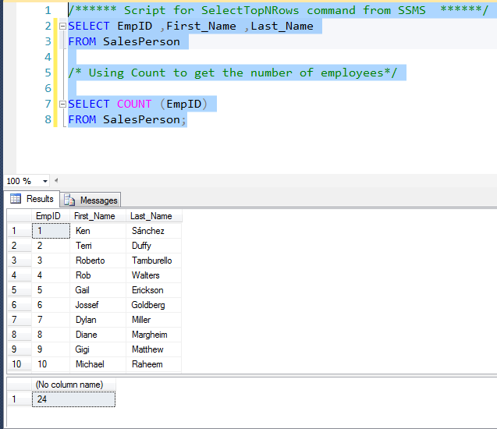
COUNT function
/****** Script for SelectTopNRows command from SSMS ******/
SELECT EmpID ,First_Name ,Last_Name
FROM SalesPerson
/* Using Count to get the number of employees*/
SELECT COUNT (EmpID)
FROM SalesPerson;

Slide 12
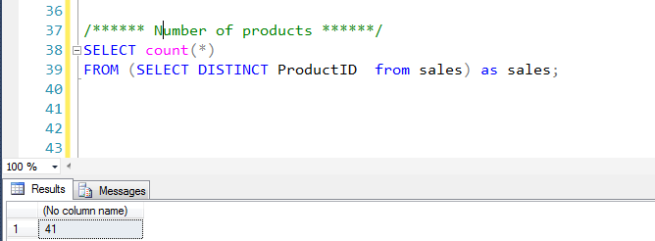
USING COUNT and DISTICT as subquery
/****** All the products with their prices with DISTICT ******/
SELECT DISTINCT ProductID from sales
/****** Number of products ******/
SELECT count(*)
FROM (SELECT DISTINCT ProductID from sales) as sales;

Slide 13
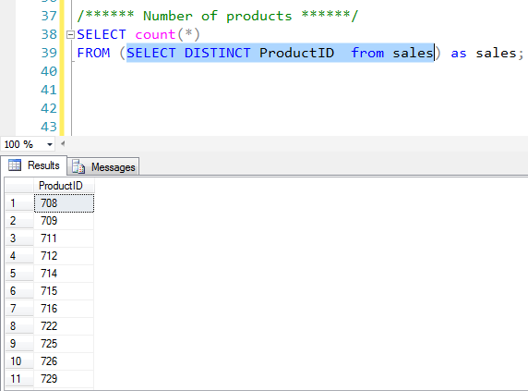
Executing a subquery
Do not forget that in most cases you can test the execution of a subquery by selecting it in the SSMS.

Slide 14
Subquery definitions
A subquery (inner query) is a SQL query nested inside a larger query
A subquery may be written in :
A SELECT clause
A FROM clause
A WHERE clause
The subquery can also be nested inside an INSERT, UPDATE, or DELETE statement or inside another subquery

Slide 15
AVG function
/* AVG Function */
SELECT AVG (Price)
FROM Sales;
/* Using AVG in Subquery */
SELECT SalesID ,ProductID ,Price ,SalesDate ,EmpID
FROM Sales
WHERE Price > (SELECT AVG (Price) FROM Sales)
ORDER BY Price;
The AVG() function returns the average value of a numeric column

Slide 16
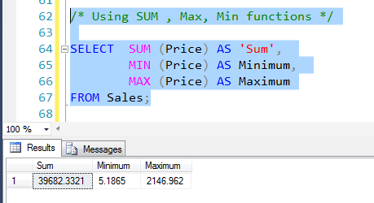
SUM , MIN, MAX functions
/* Using SUM , Max, Min functions */
SELECT SUM (Price) AS 'Sum',
MIN (Price) AS Minimum,
MAX (Price) AS Maximum
FROM Sales;

Slide 17
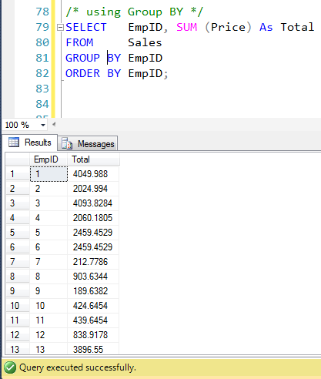
Grouping
The GROUP BY statement together with the aggregate functions will group the result-set by one or more columns.
This increases the power of built-in functions because they can now be applied to groups of rows.
/* using Group BY */
SELECT SalesID ,ProductID
,Price ,SalesDate
,EmpID
FROM Sales
ORDER BY EmpID;
/* using Group BY */
SELECT SUM (Price)
,EmpID
FROM Sales
GROUP BY EmpID
ORDER BY EmpID;

Slide 18
Student Exercise
Write a query to show the employee with the highest total number of sale?
/* using Group BY */
SELECT top 1 EmpID, SUM (Price) AS 'Highest sale'
FROM Sales
GROUP BY EmpID
ORDER BY 'Highest sale' Desc;

Slide 19
HAVING
In order to restrict the result set even more, we use HAVING.
It is possible to use WHERE instead of HAVING but an ambiguity is revealed so the standard suggests that the WHERE should be applied before the GROUP BY
In this course we will continue to use HAVING whenever we use a GROUP BY statement
/* using Group BY and HAVING */
SELECT EmpID, SUM (Price) As Total
FROM Sales
GROUP BY EmpID
HAVING SUM (Price) >2000 ;
11 rows must be returned

Slide 20
Combine Join, Scalar Functions and GROUP BY
We need to see the full name of the five (5) employees with highest total of the sales prices.
/* using Group BY and Scalar functions and join */
SELECT top 5 First_Name, Last_Name, SUM (S.Price) AS Total
FROM Sales AS S , SalesPerson AS SP
WHERE S.EmpID = SP.EmpID
group by SP.First_Name , SP.Last_Name
ORDER BY SUM (S.Price) DESC

Slide 21
Derived Tables and Aggregate Functions (Sub-Query in FROM clause)
-- Use Adventureworks
SELECT AVG(B.TotalBonus)
FROM (SELECT TerritoryID, SUM(Bonus) AS TotalBonus
FROM Sales.SalesPerson
GROUP BY TerritoryID) AS B

Slide 22
Using Subqueries in the Select Statement
SELECT SalesOrderID,LineTotal,
(SELECT AVG(LineTotal)
FROM Sales.SalesOrderDetail) AS AverageLineTotal
FROM Sales.SalesOrderDetail;

Slide 23

Restore the Subqueries database and watch the video

